Slide 1
Integrated Services Digital Network
Public networks are used for a variety of services
  Public Switched Telephone Network
  Private Lines (leased)
  Packet Switched Data Networks
  Circuit Switched Data networks

Slide 2
ISDN
Users have a variety of equipment to connect to public networks
  Telephones
  Private Branch Exchanges
  Computer Terminals or PCs
  Mainframe Computers
A variety of physical interfaces and access procedures are required for connection

Slide 3
ISDN
The telephone network has evolved into a digital one with digital exchanges and links
The signalling system has become a digital message-oriented common channel signalling system (SS#7)
The term ‘Integrated Digital Network’ is used to describe these developments

Slide 4
ISDN
The Public Switched Telephone network is still analogue from the subscriber to the local exchange
The need has arisen to extend the digital network out to subscribers and to provide a single standardised interface to all different users of public networks
ISDN fulfils that need

Slide 5
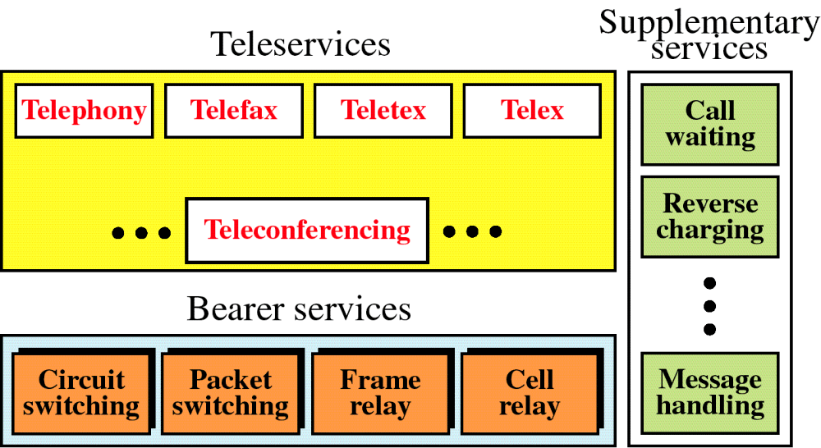
Figure 15-1
ISDN Services
WCB/McGraw-Hill
© The McGraw-Hill Companies, Inc., 1998

Slide 6
Integrated Services Digital Network
Packet
switched
network
Telephone
Circuit
switched
network
Data
terminal
Customer
ISDN
Interface
ISDN
central
office
PBX
Databases
Alarm
‘Digital
pipe’
Other
Networks
& services
LAN

Slide 7
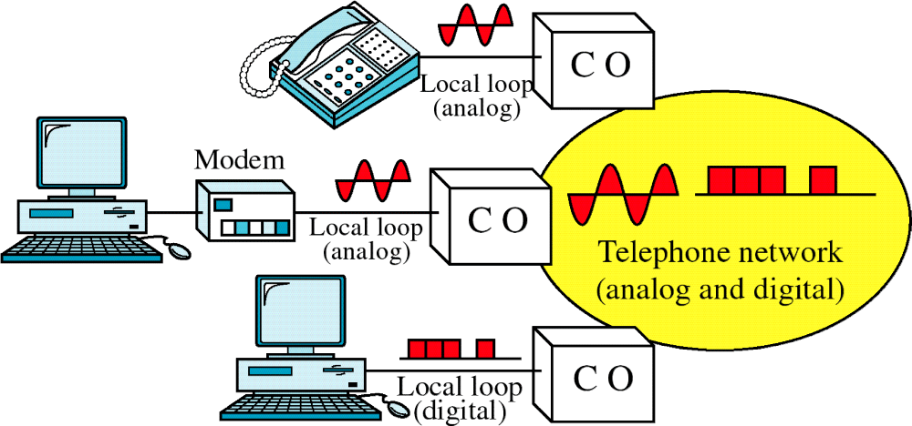
Figure 15-4
Analog and Digital Services
WCB/McGraw-Hill
© The McGraw-Hill Companies, Inc., 1998

Slide 8
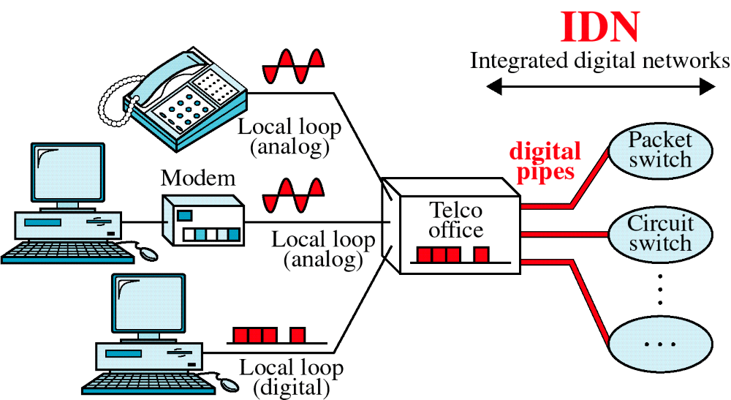
Figure 15-5
Integrated Digital Network
WCB/McGraw-Hill
© The McGraw-Hill Companies, Inc., 1998

Slide 9
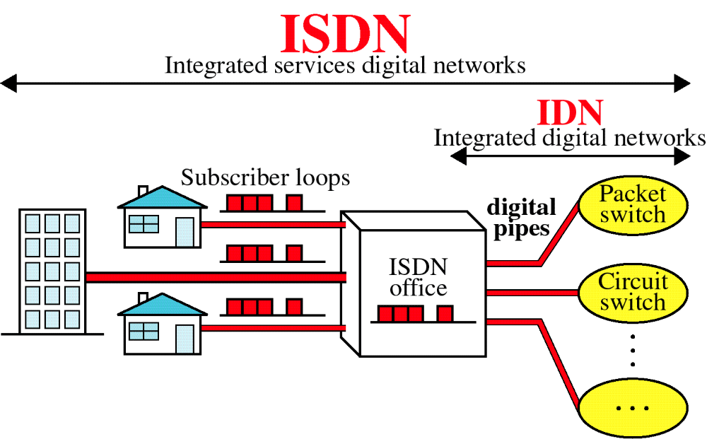
Figure 15-6
Integrated Services Digital Network
WCB/McGraw-Hill
© The McGraw-Hill Companies, Inc., 1998

Slide 10
ISDN
In Practice there are multiple networks providing the service nationally
The user however, sees a single network

Slide 11
Benefits to Subscribers
Single access line for all services
Ability to tailor service purchased to suit needs
Competition among equipment vendors due to standards
Availability of competitive service providers

Slide 12
Architecture
Integrated Digital Network
Digital circuit-
switched backbone
Common
physical
interface
ISDN
central
office
Packet-switched network
ISDN subscriber loop
Basic 2B+D
Primary 30B+D
Network-based
processing
services

Slide 13
ISDN Channels
The Digital pipe is made up of channels - one of three types
B (Bearer) channel, D (Delta) channel or H channel
Channels are grouped and offered as a package to users

Slide 14
B Channel
B channel-64 kbps
B is basic user channel
  can carry digital data or PCM-encoded voice
  or mixture of lower rate traffic.

Slide 15
B Channel
Four kinds of connection possible
Circuit-switched
Packet-switched - X.25
Frame mode - frame relay (LAPF)
Semipermanent - equivalent to a leased line

Slide 16
D Channel
D Channel - 16 or 64 kbps
Carries signalling information to control circuit-switched calls on B channels
Can also be used for packet switching or low-speed telemetry

Slide 17
H Channel
Carry user information at higher bit rates 384kbps or 1536kbps or 1920kbps
Can be used as a high-speed trunk
Can also be subdivided as per user’s own TDM scheme
Uses include high speed data, fast facsimile, video, high-quality audio

Slide 18
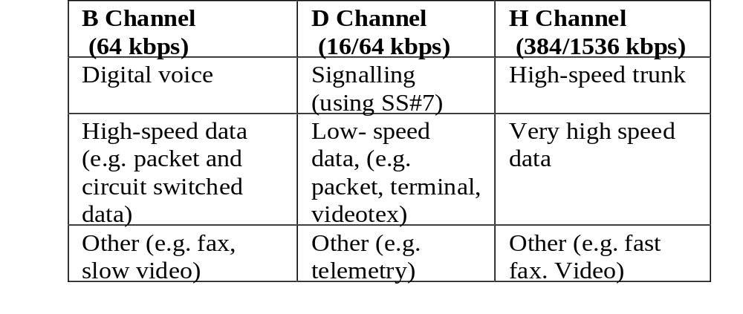
ISDN Channels and their Applications

Slide 19
ISDN Channel Groupings
Basic Access -
two 64 kbps B channels
plus one 16kbps D channel
B channels can be used for voice and data
simultaneous calls to separate destinations supported
D channel used for signalling and also for data using X.25

Slide 20
ISDN Basic Access
Intended for small business and residential use
A single physical interface is provided
Data rate is 144kbps plus 48kbps overhead bits totalling 192 kbps
Most existing subscriber loops can support basic access

Slide 21
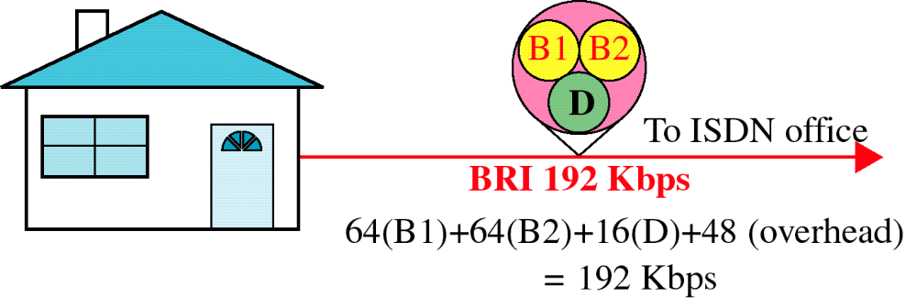
Figure 15-7
Basic Rate Interface
WCB/McGraw-Hill
© The McGraw-Hill Companies, Inc., 1998

Slide 22
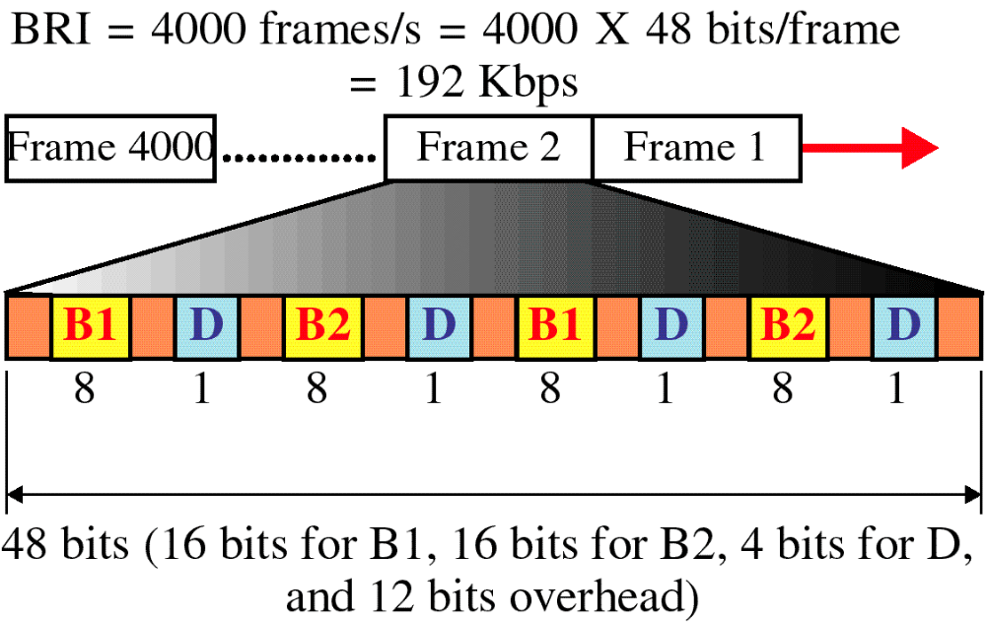
Figure 15-17
BRI Frame
WCB/McGraw-Hill
© The McGraw-Hill Companies, Inc., 1998

Slide 23
ISDN Primary Access
Intended for users with greater capacity requirements
Example would be a digital PBX
Two standards exist
  1.544 Mbps American
  2.048 Mbps European

Slide 24
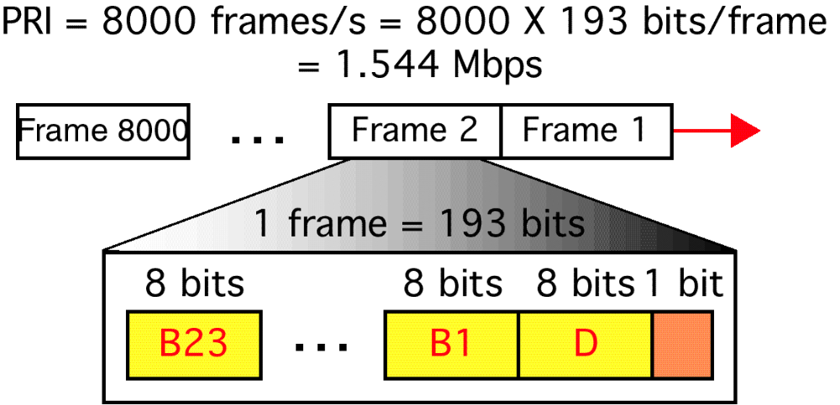
Figure 15-20
PRI Frame
WCB/McGraw-Hill
© The McGraw-Hill Companies, Inc., 1998

Slide 25
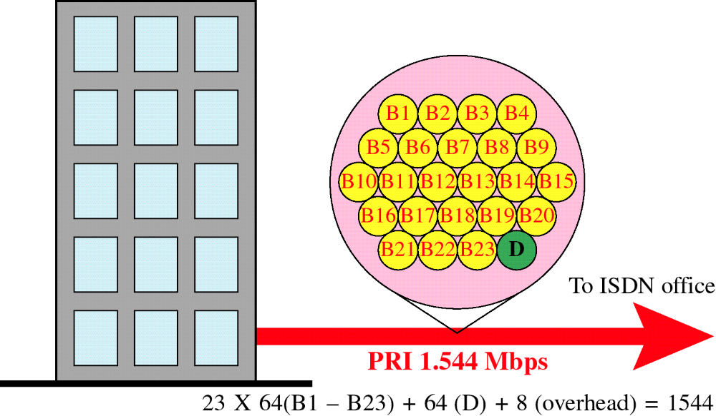
Figure 15-8
Primary Rate Interface
WCB/McGraw-Hill
© The McGraw-Hill Companies, Inc., 1998

Slide 26
ISDN Primary Access
Typically it is structured as 30 B channels plus one 64kbps D channel (Europe)
Can also be structured as H channels
  5H0 +D for a 2.048 Mbps interface
  or 1H12 +D

Slide 27
ISDN Primary Interface
Multiple channels multiplexed on single medium
Only point to point configuration is allowed
Typically supports a digital PBX and provides a synchronous TDM facility

Slide 28
User Access
Defined using two concepts
  Functional groupings of equipment
  Reference points to separate functional groupings

Slide 29
Typical User Access Layout
ISDN
Tele -
phone
NT
2-wire
Subscriber
Loop
4-wire
S-bus
PC with
ISDN
Interface
Card
User/network
Interface
Integrated
Voice/data
Terminal
Up to 8 devices
point to multi-point mode

Slide 30
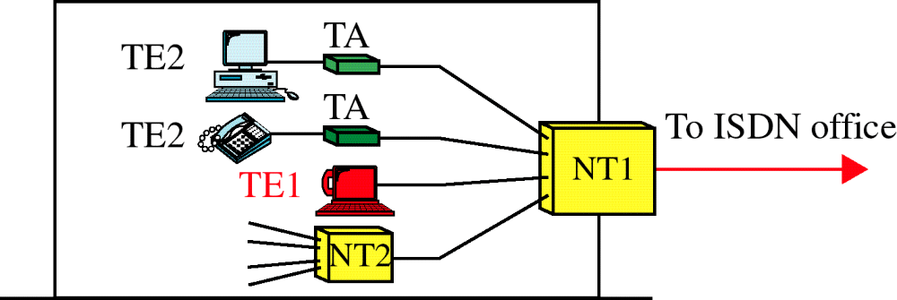
Figure 15-9
Functional Grouping
WCB/McGraw-Hill
© The McGraw-Hill Companies, Inc., 1998

Slide 31
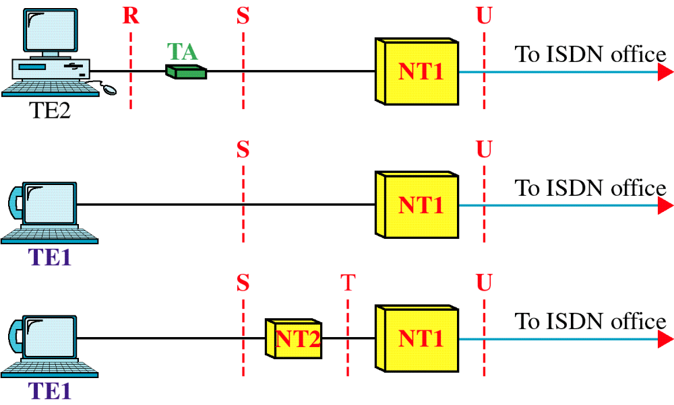
Figure 15-10
Reference Points
WCB/McGraw-Hill
© The McGraw-Hill Companies, Inc., 1998

Slide 32
ISDN Protocol Architecture
Application
End-end
user
signalling
Presentation
Session
Transport
Network
I.451/Q.931
call control
X.25
packet level
for further
study
X.25
packet level
Datalink
LAPD (Q921)
Frame
Relay
LAPB
Physical
Physical
I.430 basic interface + I.431 primary interface

Slide 33
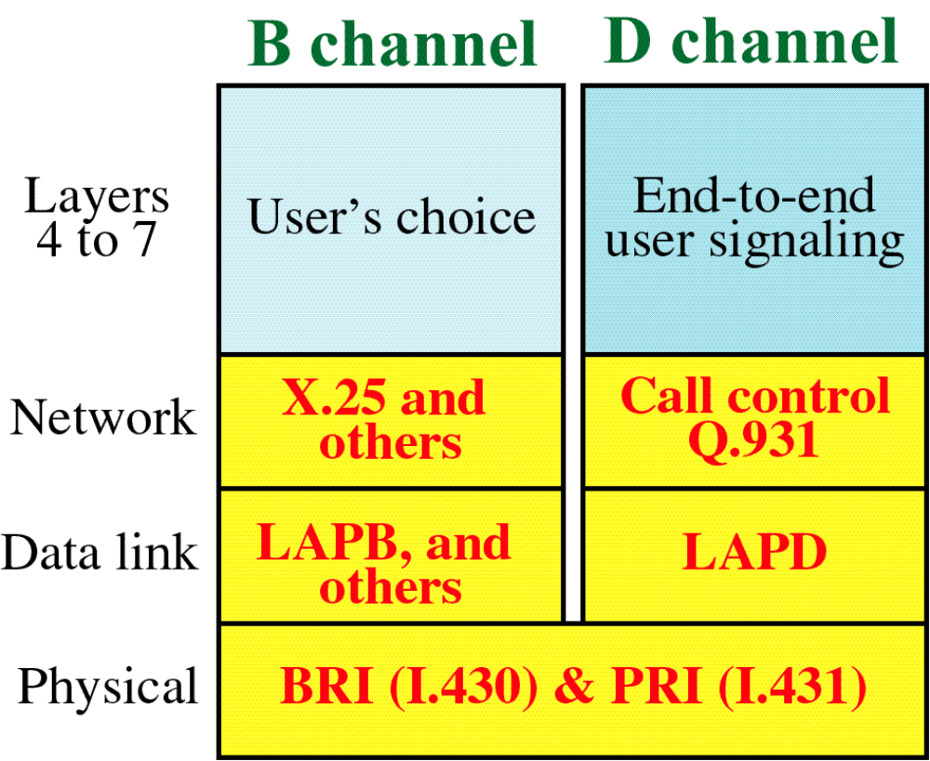
Figure 15-12
ISDN Layers for B and D Channels
WCB/McGraw-Hill
© The McGraw-Hill Companies, Inc., 1998

Slide 34
ISDN Data Link Layer
Link Access Protocol for the D channel (LAPD) defined for ISDN
Three applications are supported
  Control Signalling
  Packet Switching
  Telemetry

Slide 35
B-Channel
Uses
  Circuit Switching
  Semi-permanent circuits
  Packet switching

Slide 36
B-Channel
Circuit Switching
  Circuit is set up on B-channel on demand
  D-channel call control protocol is used
  Transparent full-duplex digital data path established between users
  Layers 2 to 7 are not visible to ISDN or specified

Slide 37
B-Channel
Semipermanent circuit can be set up by prior agreement between users and network operator
Can be for indefinite time or at specified times during day or week
As with circuit switched connection, full duplex digital data path is established
Layers 2 to 7 are not visible to ISDN or specified

Slide 38
D-Channel Packet Switching
Integrated X.25 service can be accessed by D-Channel in addition to B-Channel
ISDN provides a semi-permanent connection to a packet switching node within ISDN
The X.25 level 3 protocol is used for the packet layer
LAPD is used for the link layer

